Slide 1
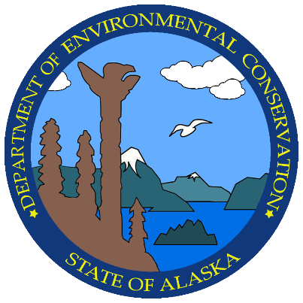
Wastewater Permitting in Rural Alaska
Alaska Department of Environmental Conservation
Division of Water
Wastewater Discharge Authorization Program
Gene McCabe

Slide 2
Division of Water
Mission Statement:
  Improve and protect water quality
How?
  Establishes standards for water cleanliness
  Regulates discharges to waters and wetlands
  Provides financial assistance for water and wastewater facility construction and waterbody assessment and remediation
  Trains, certifies, and assists water and wastewater system operators
  Monitors and reports on water quality

Slide 3
Permitting Overview
Wastewater permitting authority stems from the Clean Water Act
EPA administers nationwide permitting, but can delegate to States and Tribes
State of Alaska authority comes from AS 46.03.100
Governing State Regulations:
18 AAC 15 – Administrative Procedures
18 AAC 70 - Water Quality Standards
18 AAC 72 – Wastewater Discharge
18 AAC 83 - APDES

Slide 4
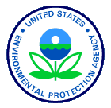
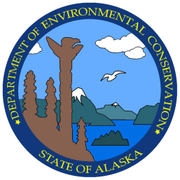
Alaska Pollutant Discharge Elimination System (APDES)
          NPDES APDES
DEC
Water
Environmental Health
Air
WDAP
SPAR
Admin
Oil & Gas
Domestic
Mining
Stormwater
Engineering Spt

Slide 5
Rural Alaska Challenges
Limited capital funding and high construction costs
High O&M costs and non-cash based economies
Retaining skilled operators and knowledge transfer
Monitoring and reporting system performance
Vague basis of design guidance

